Slide 1

Food Delivery Website

Slide 2
Food Delivery Website

Slide 3



Introduction
Name – Dev Shah
Project title - Food Delivery Website
Division – A1
Roll no. - 13
Enrollment no - 21002170110169
Subject – FSD Individual Project

Slide 4
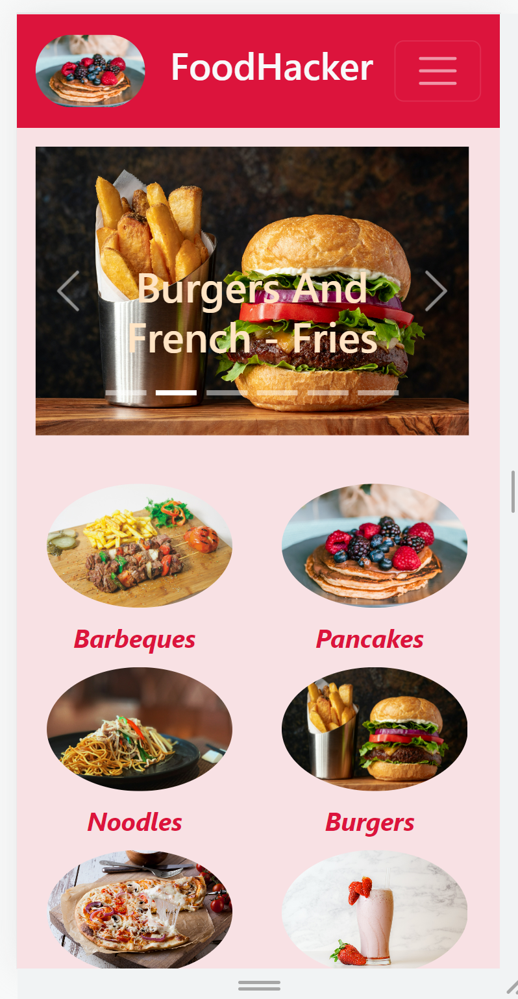
Menu display
Displays layout of menu page
Here I had uploaded some videos with CSS applied on it
It also has concept of Scrollspy on the nav-item of "Know More"
Moreover In order to make responsive it uses bootstrap concept of collapsible navbar, which toggles when button toggles
It also contains "Contact Us" feature.
It Uses Bootstrap Carousel to display images. of items

Slide 5

User Friendly Interface
It lets you feel comfortable by making as user friendly interface by making it responsive with the help of Bootstrap.
It Moreover also provides you video of the item that is been sold by the website.
It gives you "Quantity" button to add number of quantities you want.
It also gives "Total Price" of all Items, "Sub Price" of all items along with the its "Total Quantity".

Slide 6
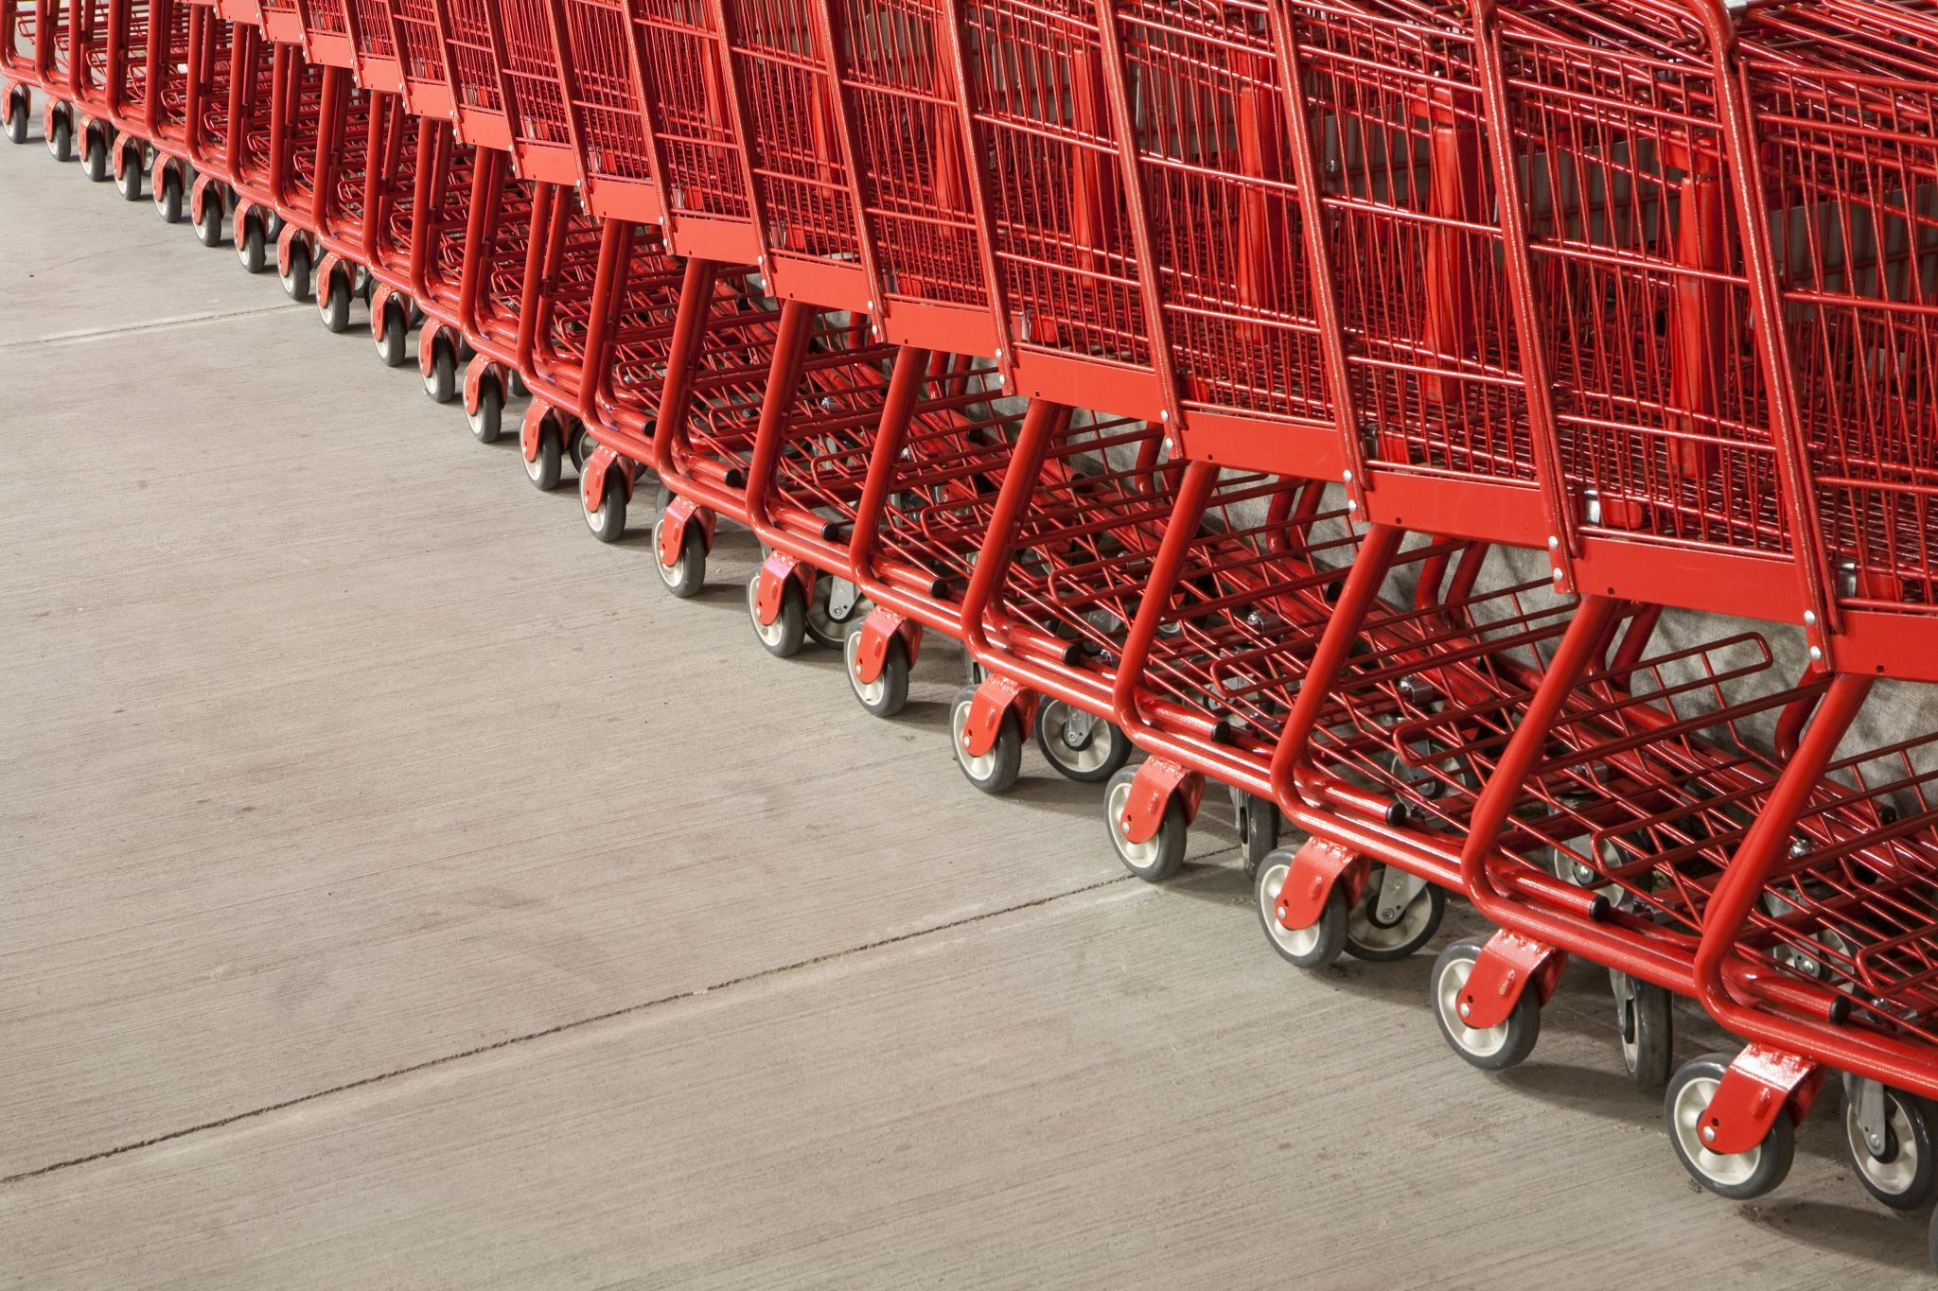
Add To Cart option
It adds items to cart by passing variables through session . .storage
This is most important part of the website.
It returns 4 variables according to the requirement of the User
Total Quantity Required
Total Price Of All Items
Sub quantity of the Items
Sub Price Of Entered quantity od Item

Slide 7

Fully Responsive
Bootstrap Grid System
It Is made fully responsive by applying different media queries in different cases.
Main uses of the website includes following concepts that makes it even more responsive at every cases :
Bootstrap Collapsible Navbar
Bootstrap Flex row and Flex Column classes
CSS Flex method
Media Queries for different sizes
Other than it uses videos to implement different styling features like text-blend etc.

Slide 8
Thank You

